Slide 1
Mechanical

Slide 2
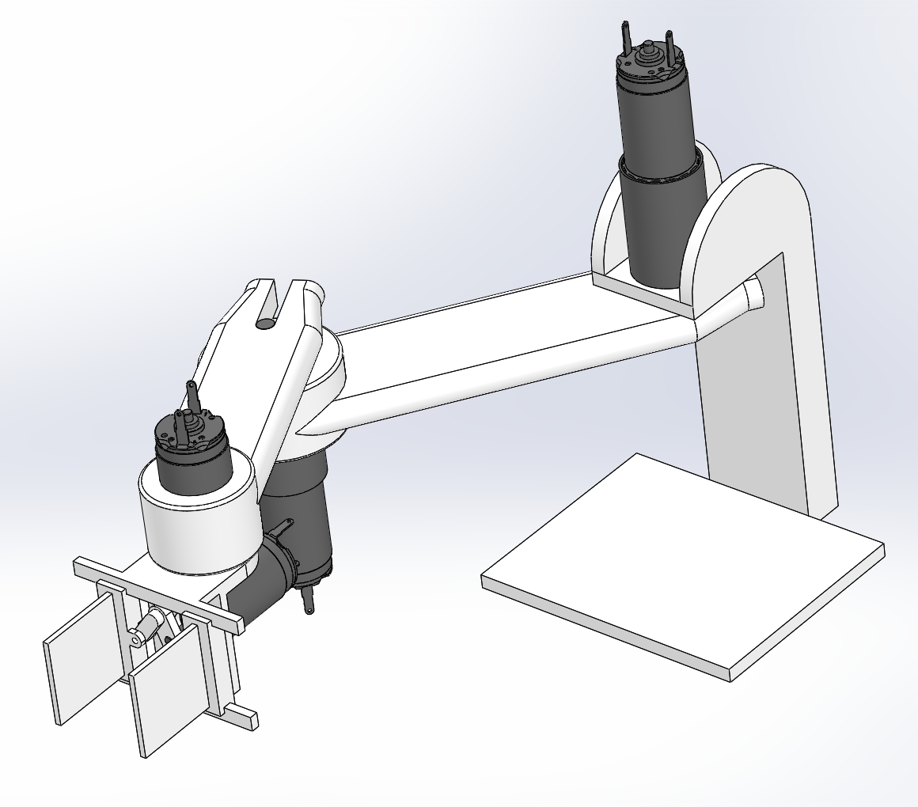
3D Design
[McMaster Carr fasteners]
[3D printable arms]

Slide 3
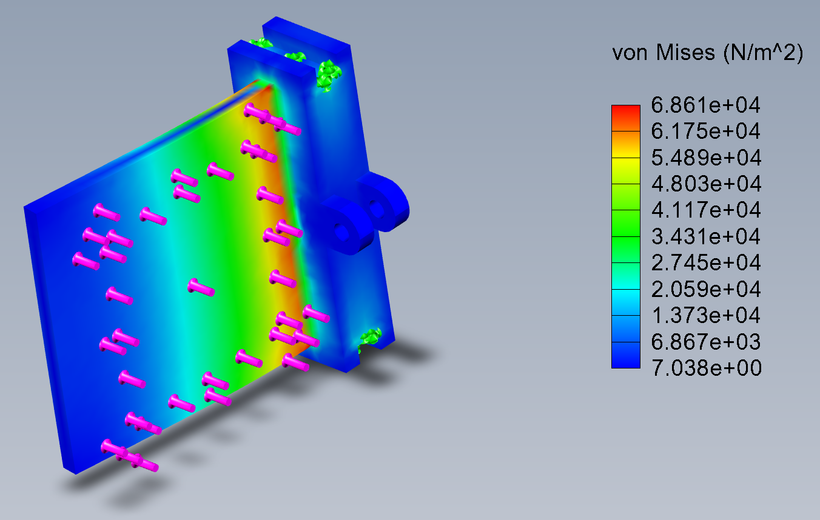
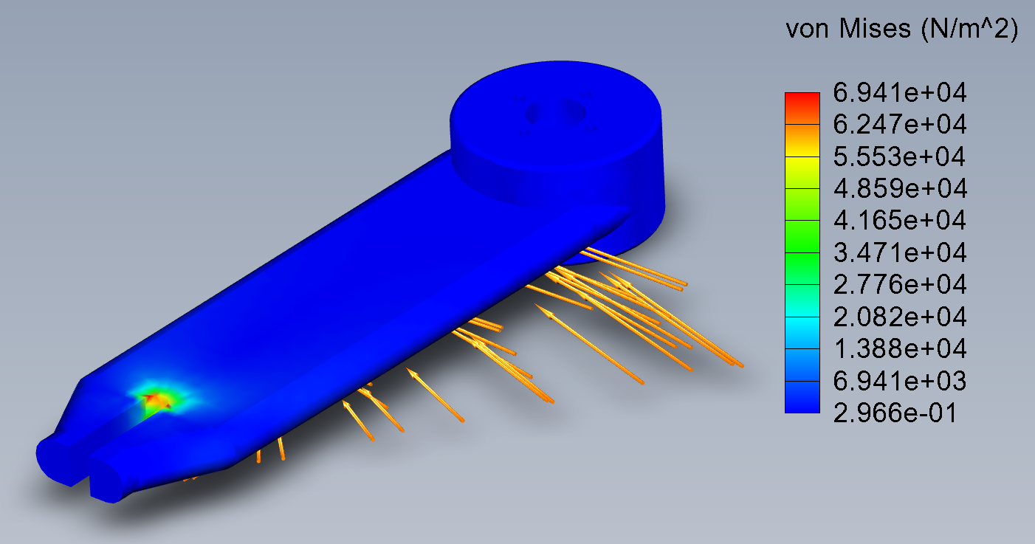
Stress Tests
Simulated at rated motor torque of 12mNm

Slide 4
Linear Model

Slide 5
SimulationX Model

